Slide 1




Incorporating Inductive Bias into Deep Learning:
A Perspective from Automated Visual Inspection in Aircraft Maintenance
Vincentius Ewald
Co-Author:
Xavier Goby | Hidde Jansen
Dr. Roger Groves | Prof. Rinze Benedictus
10th International Symposium on NDT in Aerospace
Dresden, 24 – 26 October 2018
Notes:
Good morning everyone, first of all thank you for giving me the opportunity to present my topic today. My name is Vincentius Ewald and I am from Delft University of Technology in the NL.

Slide 2
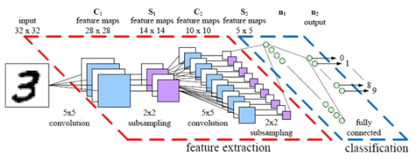



Deep Learning: What and Why?
1
10th ISNDTA
OCT-2018
Dresden, DE
Presenter:
V. Ewald
Def.: Hierarchical machine learning of data representation
Most of the time: NeuralNet with >2 hidden layers
Example of DL architectures:
Deep Convolutional Net (S)
RecurrentNet: LSTM/GRU (S)
Adversarial Network (U)
Stacked AutoEncoder (U)
…..
Why deep learning?
→ Pure physical model: Difficult to develop
→ Reliable prediction from statistical data
Notes:
I hope everyone here in this room has a bit of grasp of artificial intelligence particularly ML.
So if you heard already about ML, DL is a sub-class of ML and specifically per definition DL is hierarchical machine learning of data representation, and 99% of the time this means neural network with 2 hidden layers.
Sometimes the term deep learning is used interchangeably with deep neural network and in principle they are the same.
So there are many architectures of DL, one of them is DCNN which is typically trained in supervised way. There is also recurrent neural network such as LSTM/GRU.
Other types of DL are Adversarial Network and AutoEncoder with which you can regenerate an input into new output and there are many more.
But this is a bit too much, so what I can give you as an easy example as demonstrated by my student Xavier this morning is DCNN.
The way it works is super easy, you feed the neural net with your input – say it‘s digit three, then it will be passed through next layers several times until classification layer.
So typically it works like this: you have a black and white pixel represented as 0 and 1, and this is convoluted through 3x3 filter and what you get in the next layer is the convolved feature of your input.
You do that several times until the classification layer where the abstract representation of the features will be evaluated – so this correspond to what classes.
Now, OK to answer to question why do we need deep learning? Well, first of all we know that pure physical model is sometimes difficult to develop and it would take tremendous amount of time.
Secondly we heard many examples from CS domain that by using DL they can get reliable prediction just by learning the hidden pattern in statistical data.
Then I said, OK so let‘s believe what they said, but one thing is for sure: we can‘t copy everything from CS directly – we need algorithm that generalizes well in our aerospace domain.
And for sure, nothing comes free of cost. There is always an issue, a problem, in solution.

Slide 3

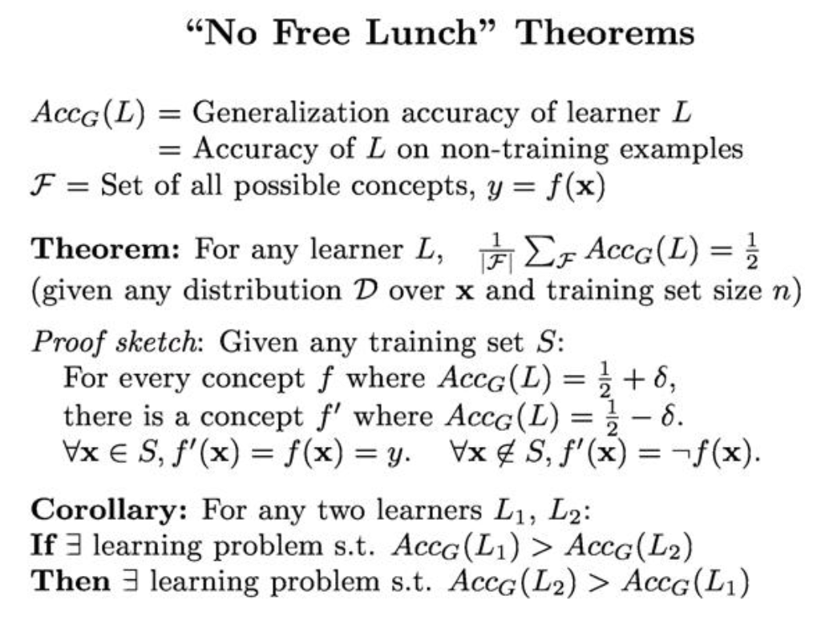
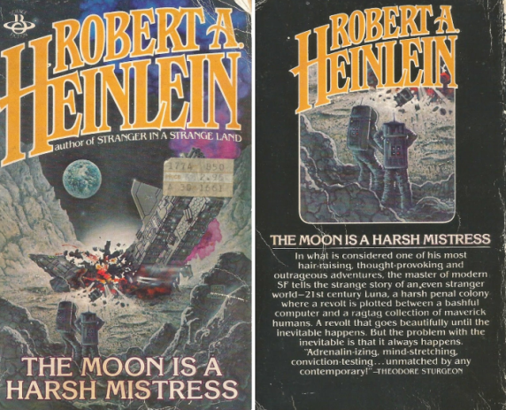
Issues and Mitigation on Deep Learning
1
10th ISNDTA
OCT-2018
Dresden, DE
Presenter:
V. Ewald
Issues:
→ Big data required to obtain model parameters
→ More importantly, is it interpretable outcome?
Mitigation:
→ AI needs human intervention
→ Introducing domain bias
Notes:
And yes, there is always an issue with deep learning.
But before getting too much into detail, I would like to point out that there is a novel written in 1965 by Robert Heinlein called The Moon is Harsh Mistress.
And the famous quote from this novel can be seen there in the screen.
So this novel is science fiction - but interestingly science fiction sometimes develops into scientific language.
And there if you ask mathematician, they can give you more detail on the "NFL" theorem.
You can lookup in Google - this is trivial, OK?
We're not going to proof the maths here, but if I can simplify the corollary here, my main message would be:
One algorithm might outperform another algorithm for certain task, but for another task it might be the vice versa.
So here, what I would like emphasize is that:
In comparison to other machine learning, DL won't work without huge amount of data.
But more importantly, even that DL is able to do its job in perfect way, would the outcome be interpretable?
So, to mitigate the issue, I believe the same way like CS do: maybe AI should not start from scratch.
Maybe AI needs human intervention and this is the time to introduce domain bias.

Slide 4
Statistical Model
2
10th ISNDTA
OCT-2018
Dresden, DE
Presenter:
V. Ewald
Model Space S
Model consistent with data
Correct model ●
High bias, low variance model
More data helps
Adding bias can help
Or it can hurt
Michael C. Mozer
U Colorado Boulder
ISS-DL (Bilbao 2017)
Notes:
Now let's try to chill a bit and let's go back to statistics 101.
So, normally what we would like to have found perfectly one correct model in the jungle of model space.
But this is very difficult, right? Looking for a correct model is like looking a needle in the universe.
So what we can do is to collect data as many as possible and eventually we reduce the search space.
Another way to further reduce the search space we can add some bias or guidance to our model so it fits to our expectation.
But adding bias is double-edge sword. It could be blessing and a curse.
Why? Because adding too much bias can actually lead our model further away from the correct model.

Slide 5
Inductive Bias
2
10th ISNDTA
OCT-2018
Dresden, DE
Presenter:
V. Ewald
Formalization:
Empirical Model
Def.: Loss = Bias + Variance + Noise
Def.: The inductive bias of learning algorithm A is “any minimal set of assertions B such that for any target concept c and given data set D” that:
My main message is:
Adding bias to model is not neccesarily bad, if suitable to domain
→ But how?
x
y
Given data set
D = {(x₁,y₁),…,(x_{n},y_{n})}
y = f(x)
Notes:
Alright, now let's wrap up and formalize this in mathematical way.
Simply speaking, an empirical model can be described as this black box.
On one side we try to influence a system by using parameters X, and on the other side we how the system behaves and express the system behavior in variables Y.
Finally this can be summarized in matrix D which consists of data pair {x1,y1}, {x2,y2}, and so on.
So, how do I know whether my model is near to correct or not?
Well, the easiest part is to measure the distance or the loss.
And per definition, loss is defined as the sum of bias, variance, and noise - or in mathematical term it can be written like this.
I told you in the slide previously, right? That bias can help but it can also drive us away from the correct model - meaning the loss increases.
Now, specifically, as defined by Mitchell in 1997, inductive bias is: ....
OK, we don't need to go too detail into statistics 101, but here my main message is: ....

Slide 6
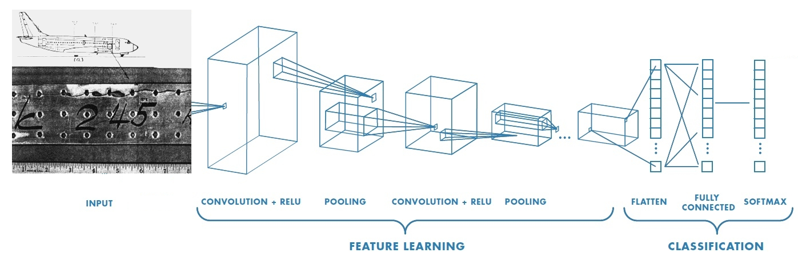
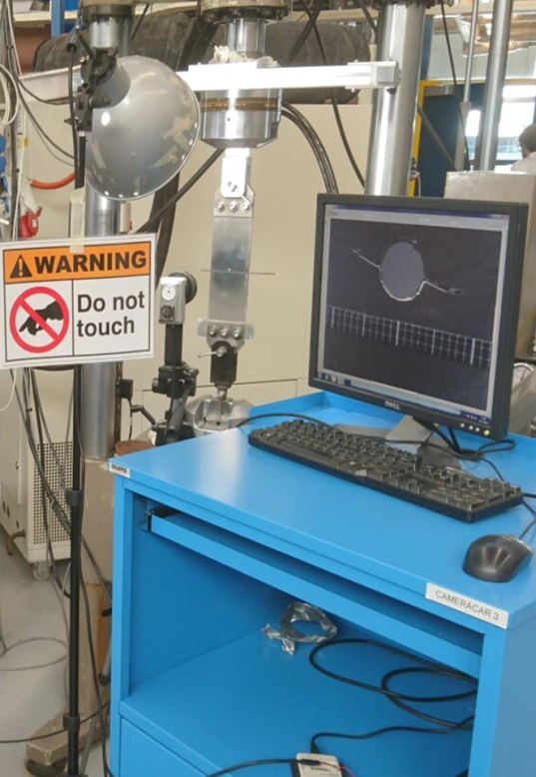
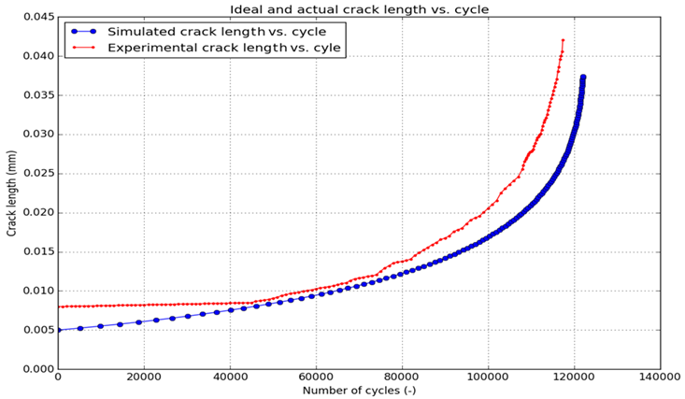
Adding Aerospace Bias into Deep CNN
3
10th ISNDTA
OCT-2018
Dresden, DE
Presenter:
V. Ewald
→ Example from aerospace domain: Building ConvNet that classifies crack length according to crack propagation behavior (AFGROW & Fatigue Test)
We fed the ConvNet with about 11800 images
Bias: 4 Crack Length Classes (97.55% Accuracy after 20 training epochs)
→ ConvNet should be able to generalize!
111000
55 mm
74000
24 mm
44000
16 mm
Failure
79 mm
Notes:
There are many ways to incorporate inductive bias.
Here we show an example from aerospace domain: We built deep ConvNet that classifies crack length according to crack propagation behavior that we obtained from fatigue test and AFGROW simulation.
The bias here is: we assume that the crack propagation behavior can be described in 4 cluster images that we assign manually. We got the images from the camera and we just sort the images into 4 different folders and each corresponds to particular crack length.
Most important thing: The ConvNet should be able to make generalization -> it is able to accurately predict new input it hasn‘t seen before into correct class

Slide 7
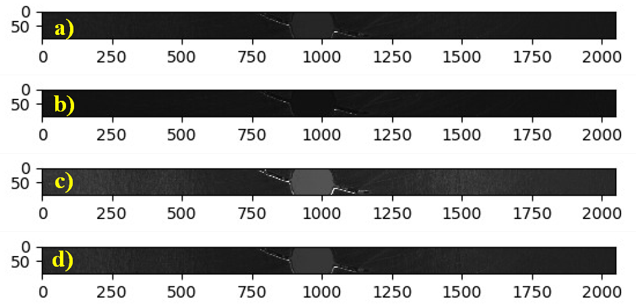
What if we don’t?
3
10th ISNDTA
OCT-2018
Dresden, DE
Presenter:
V. Ewald
→ Conduct separate run: unsupervisedly assign 11800 images into 4 clusters
k-mean clustering analysis (KMCA = unsupervised learning)
→ KMCA found 4 clusters, but classified into to 4 different light intensity!
Fed into same ConvNet: 99.45% accuracy after 6 training epochs
USELESS IN
STRUCTURAL
MECHANICS !!
Notes:
- We tell the k-mean to find 4 different clusters with the hope it will classify our 11800 images into 4 categories of images different crack length
- Surprise surprise… It found 4 different categories of images, but it was not classified according to 4 different crack lengths, but different light intensity (the fatigue test was run for 22 hours at TU Delft lab and there is different sun light intensity during that day)
- Out of curiosity, we still feed these images into exactly the same ConvNet, and another surprise: it reaches 99.45% accuracy after only 6 epochs

Slide 8
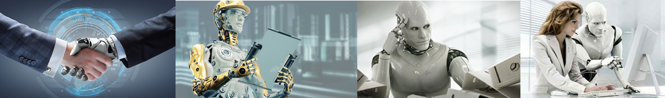
Conclusion
4
10th ISNDTA
OCT-2018
Dresden, DE
Presenter:
V. Ewald
1. I agreed with Computer Sci community, DL has definitely big potential
However, DL is certainly pegged to availability of big data
Implicitly, NDA: are airlines and OEM ready to share their data?
Another moral story: don‘t always trust the machine to do everything
→ High accuracy sometimes doesn‘t mean anything (97.5% vs 99.5%)
Future of NDT/SHM should NOT be human-only or machine-only
→ Reciprocal HCI (Humans make mistake – so does machine)
Notes:
- Agreed with CS community, DL has big potential
- However, this is pegged to availability of big data (our data was only small big data, we had 48 GB within 22 hours, normally in social media this within a minute)
- Practically: NDA (not GDPR related BTW) -> Readiness of airlines and OEM sharing their data?
- But another moral story: don‘t always trust the machine to do everything, higher accuracy sometimes doesn‘t mean anything (cf. 97.5% vs 99.5%)
- We believe that future of NDT/SHM would not human-only or machine-only, but rather a reciprocal HCI (Human made mistake – so does machine)

Slide 9


Thank you for your attention!
For any further questions: V.Ewald@tudelft.nl
Researchgate:
www.researchgate.net/profile/Vincentius_Ewald

